Slide 1
MISSILE GUIDANCE SYSTEMS
Presented By:
KRISHNA SHASHANK

Slide 2
GUIDED MISSILES
Self-propelled aerial projectiles containing explosives
Guided either by remote control or internal mechanisms
5 categories – surface to surface, surface to air, air to surface,air to ground & air to air
Based on area of operation – tactical,support & strategic
Based on flight characteristics – aerodynamic & ballistic

Slide 3
MISSILE COMPONENTS
Guidance, control, armament & propulsion sections
Guidance – brain of the missile, directs its manoeuvres
Control – executes the manoeuvres
Armament – carries the explosive charge and the fusing & firing sections
Propulsion – propels the missile
Guidance orders are initiated by electronic sensing systems

Slide 4
WORKING OF A GUIDANCE SYSTEM
Consists of 2 separate systems – altitude control & flight path control
Altitude control – maintains the missile in the desired altitude by controlling it in pitch, roll & yaw
Flight path control – guides the missile to its designated target; done by determining flight path errors & generating orders for error correction
Orders then sent to missile control sub-system which exercises control to maintain flight path

Slide 5
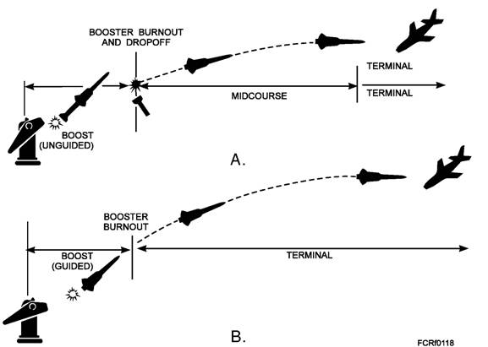
PHASES OF GUIDANCE
3 phases – boost, midcourse, terminal

Slide 6
BOOST PHASE
Missiles are boosted to flight speed by booster component of propulsion system
Lasts from the time missile is launched until booster burns up its fuel
Missiles aimed in specific direction on orders from fire control computer
This establishes line of fire along which missile must fly during boosted period
At the end of boost , missile must be at pre-calculated point
Essential that it provides stability to missile

Slide 7
MID-COURSE PHASE
Not always present; but when present it is the longest in time & distance
Changes may be needed to bring missile onto desired course & to keep it on course
Puts missile near target, from where terminal phase takes over control

Slide 8
TERMINAL PHASE
Highly important phase
Must have high degree of accuracy, fast response to guidance signals to ensure an intercept
Missile may need to manoeuvre to its max capability to make sharp turns to overtake & hit a fast moving & evasive target
In some missile manoeuvres are limited during the early part & becomes more responsive to error signals during later stages

Slide 9
TYPES OF GUIDANCE SYSTEMS
Inertial guidance
Command guidance
Beam-rider guidance
Homing guidance – active, semi-active, passive
Optronic guidance
TERCOM guidance system

Slide 10
INERTIAL GUIDANCE
Missiles controlled by self-contained accelerometers
Accelerometers measure vertical, lateral & longitudinal accelerations
During flight outside forces cause changes in speed commands which are transmitted to missile by-radio uplink transmitter or by varying characteristics of missile guidance beam
This data is taken by onboard computers & converted to precise position of missile
Lately inertial systems have been combined with GPS – used in ICBMs
Suffer from drift – chances of missing target are higher

Slide 11
COMMAND GUIDANCE
Missile
Target
Command
Transmitter
Missile
Tracker #2
Target
Tracker #1
Computer

Slide 12
BEAM-RIDER GUIDANCE
Missile seeks out centre of controlled directional energy beam – radar beam
Beam provides information regarding position of missile to guidance system
System interprets this information & generates its own correction signals to keep missile at centre of beam
Fire control radar points beam at target and the missile "rides" the beam to the target
As beam spreads out – more difficult for missile to remain at centre of beam
As range increases, accuracy of beam-rider decreases
Effective only against short & medium range targets

Slide 13
Beam Rider Guidance
Tracking
Beam
Narrow
Guidance
Beam

Slide 14
HOMING GUIDANCE
Controls path of missile by means of a device in missile that detects and reacts to some signal from target
Signal may be light, radio, sound, heat waves or magnetic field
System tracks energy reflected off target
Missile derives guidance error signals based on its position relative to target
Most accurate type of guidance
3 types – active , semi-active & passive

Slide 15
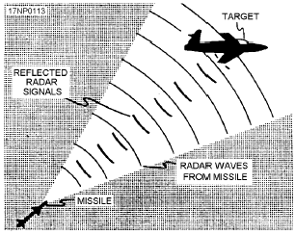
ACTIVE HOMING
Target illuminated by component within missile – radar transmitter
Radar signals transmitted by missile, reflected off the target & received back by receiver
This gives information – target’s distance & speed
Missile sends electronic commands to control section
Control section Controls angle of attack

Slide 16
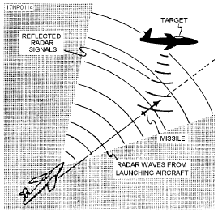
SEMI-ACTIVE HOMING
Target illuminated by external source – transmitter carried in launching aircraft
Receiver in missile receives reflected signals , computes information & sends electronic commands to control section
Hawk antiaircraft systems

Slide 17
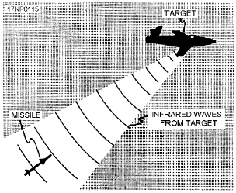
PASSIVE HOMING
Directing intelligence is received from target itself
This may be a source of infrared rays (such as the hot exhaust of jet aircraft) or radar signals (such as those transmitted by ground radar installations)
Missile receiver receives signals generated by the target and then the missile control section functions in the same manner

Slide 18
OPTRONIC MISSILE GUIDANCE
Advantages such as high resolution , no signal emission compact size and low weight of the onboard equipment
Includes highly-sensitive small-size sensors and ground-based information systems for receiving and processing images, generating target designation and reference data and to promptly transmit the data to the missile launch sites
More efficient in overcoming anti-missile defense zones and do not deviate from their target by more than a few meters
Used in Tomahawk cruise missiles

Slide 19
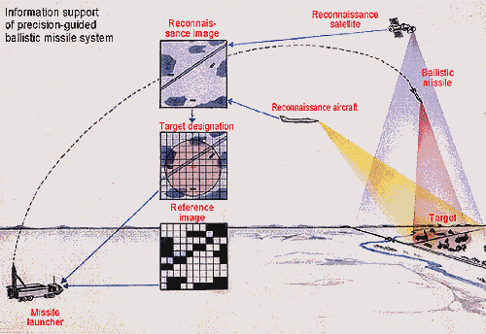
Optronic guidance system

Slide 20
CELESTIAL GUIDANCE SYSTEM
First used in american poseidon missile
Uses star positioning to fine-tune the accuracy of inertial guidance system
Potentially very effective means of improving accuracy

Slide 21
TERCOM GUIDANCE SYSTEM
TERCOM (Terrain Contour Matching) is used to solve the problem of drift
Radar used to scan the ground/terrain that the missile is passing over. The terrain data is compared to the digital maps stored in the computer on the missile
If a drift is noticed, the inertial navigation system is corrected and a course correction is made to put the missile back on path .This is repeated a number of times
Advantages are that missiles fly very low - coupled with their small size and radar cross-section, low infrared signature, they become virtually undetectable by enemy radar
GPS can be used to complement data computed by inertial system

Slide 22
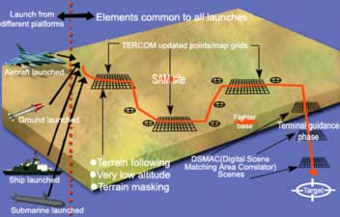
TERCOM guidance system

Slide 23
POLYPHEM FIBRE-OPTIC GUIDED MISSILE SYSTEM
Uses infra-red imaging for high precision targeting
Transmissions through fibre-optic cables
System uses advanced image processing algorithms,electro-optical converters and radio links
Main part of the guidance system is the infrared imager
Fibre-optic links provide high data transmission rate,immunity to active jamming and electro-magnectic interference

Slide 24
Guided Flight Paths
Preset
  Constant:
    Fixed before launch.
    Once launched, profile cannot be changed
  Programmed
    Weapons has several programmed phases
Variable
  Pursuit
  Constant Bearing
  Proportional Navigation
  Line-of-Sight (being phased out)

Slide 25
Pursuit Path
Points the target
at all times.

Slide 26
Constant Bearing Path
X
Initial Target Path
Intercept
Point
New Path
Constant Bearing
Path

Slide 27
Proportional Navigation
A receiver measures the rate of change of the line of sight to the target and new steering commands are generated
The weapons chooses a course in which the rate of change of the weapons heading is directly proportion to the rate of rotation of the line-of-sight from the weapon to the target
Initial
Range

Slide 28
Line of sight
This is being phased out
This is different from the others because the line-of-sight is from the launch platform to the target and the weapons stays in the line of sight.

Slide 29
Putting It All Together
REFLECTION FROM
THE TARGET
ANTENNA
BEAM
LAUNCH CYCLE OR LAUNCH TO EJECT CYCLE (LTE)
PROGRAMMED FLIGHT OR MAINBEAM AVOIDANCE MANEUVER (MBAM)
SEMIACTIVE MIDCOURSE GUIDANCE SEMIACTIVE (SA)
ACTIVE TERMINAL GUIDANCE ACTIVE (A)
PRESS
“LAUNCH”
SEPARATE
INITIATE
SEMIACTIVE MODE
INITIATE
ACTIVE MODE
IMPACT

Slide 30
Conclusion
Guidance System is a complex system which involves several systems working in tandem
Development of missile involve huge expenditures – essential that guidance system is properly designed for accurate interception of targets

Slide 31


